Slide 1
CHANGE OF PARADIGM OF SUSTAINABLE GREEN TOURISM JULIAN ALPS, SLOVENIA Vestland: 17.03.2021 M.Sc. Helena Cvenkel,director for research and development BSC Kranj Regional development agency of Gorenjska

Slide 2
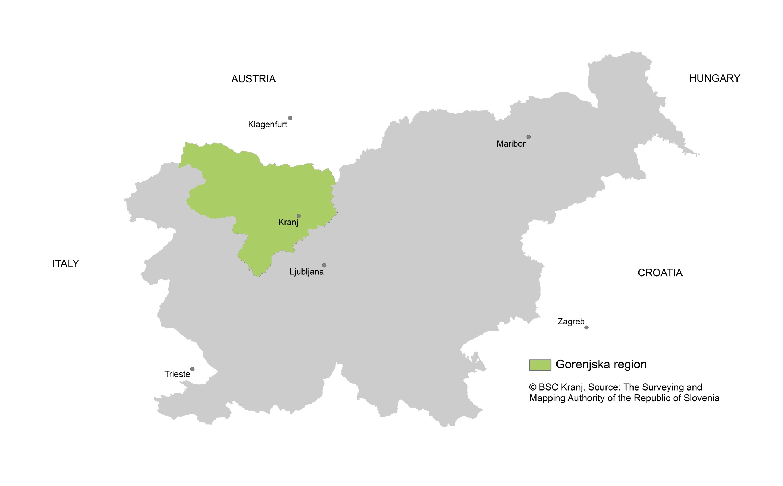
Gorenjska/Slovenia

Slide 3
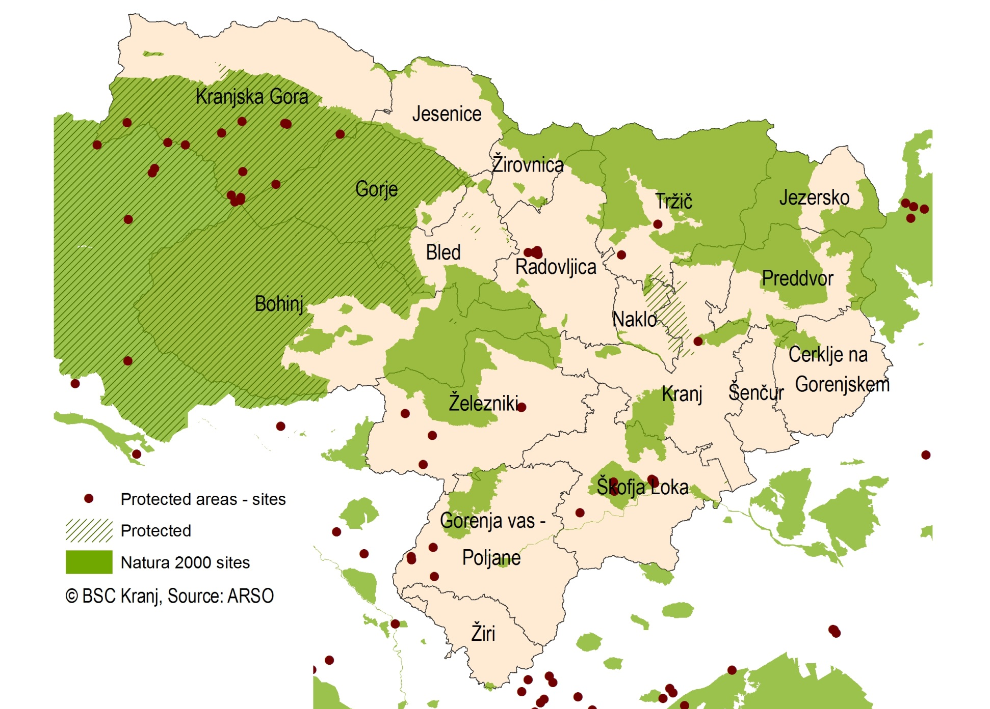
Julian Alps Protected areas and Natura 2000

Slide 4
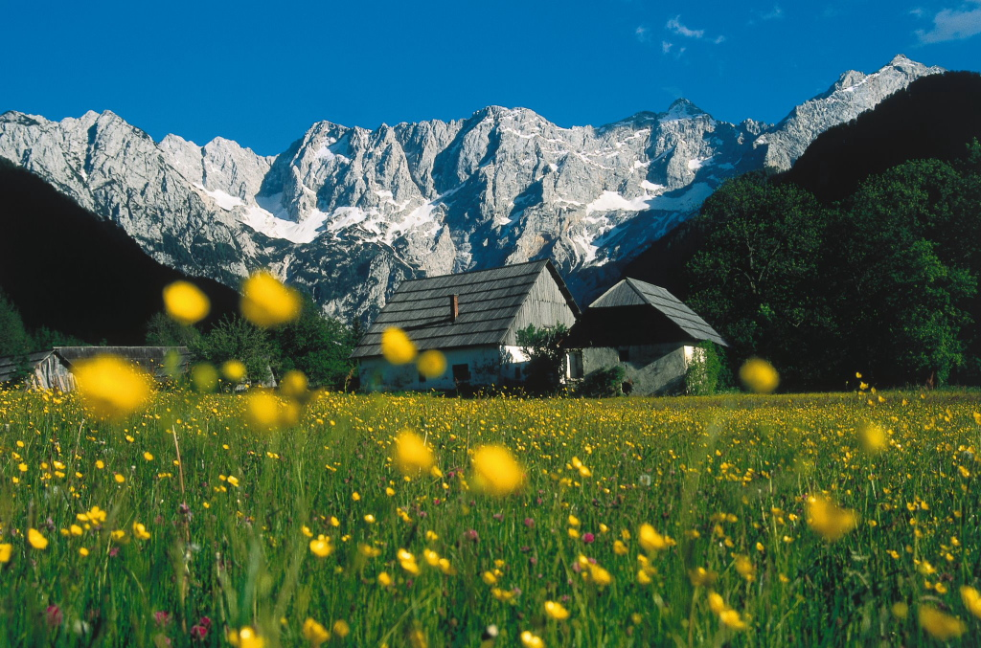
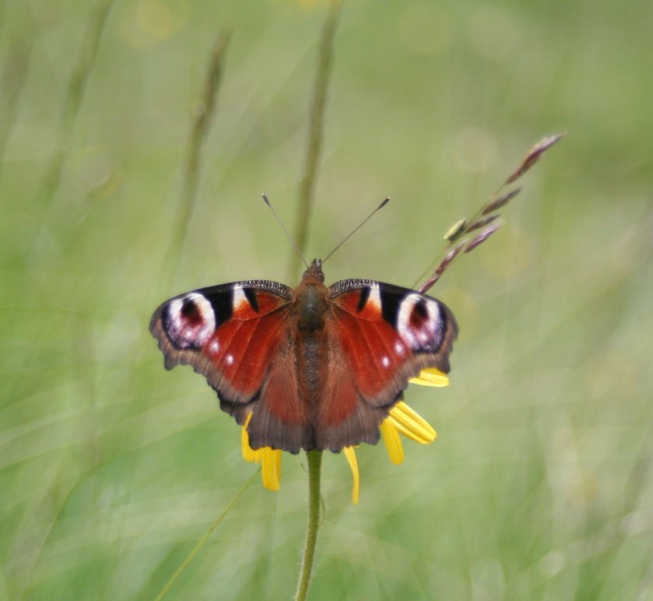
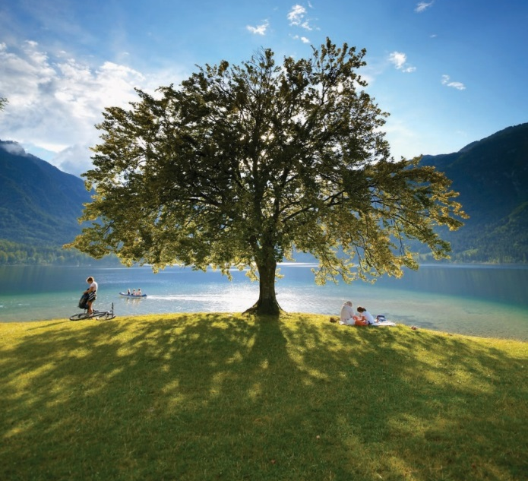
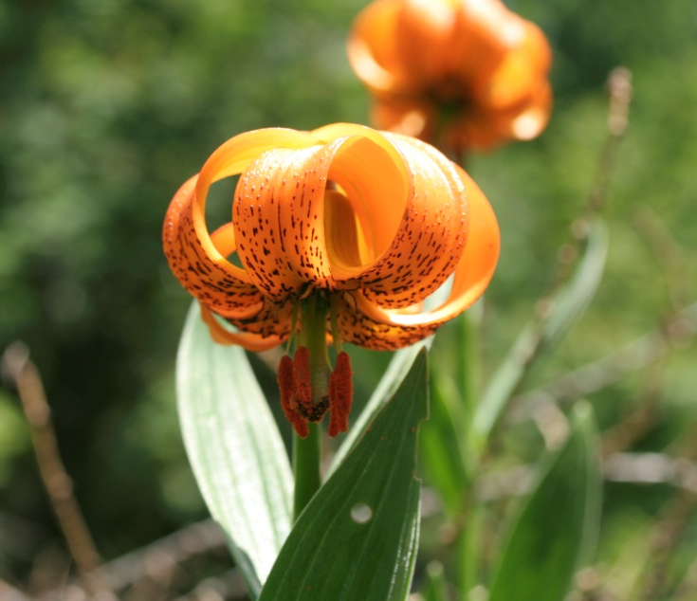

Slide 5
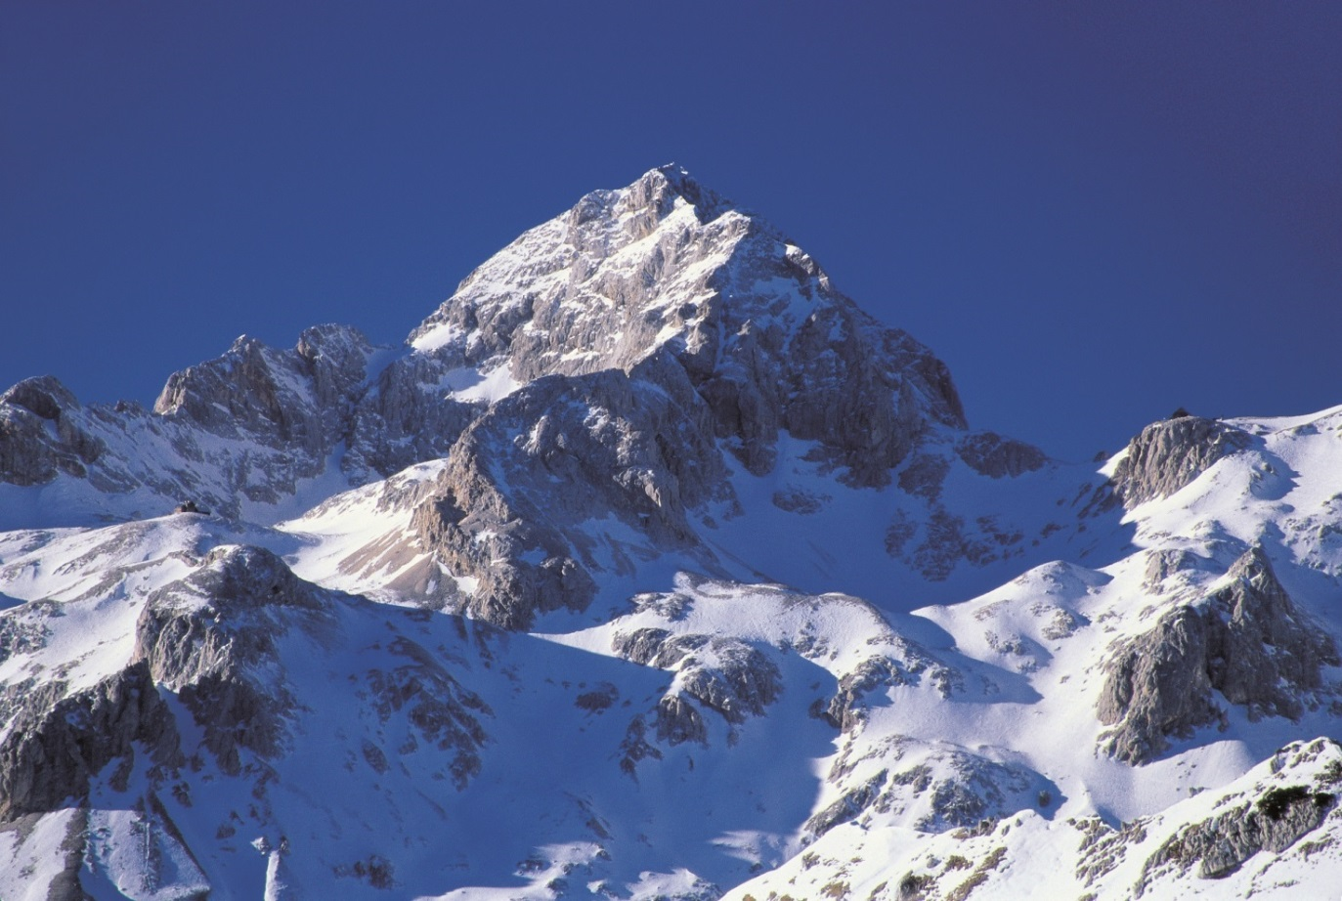
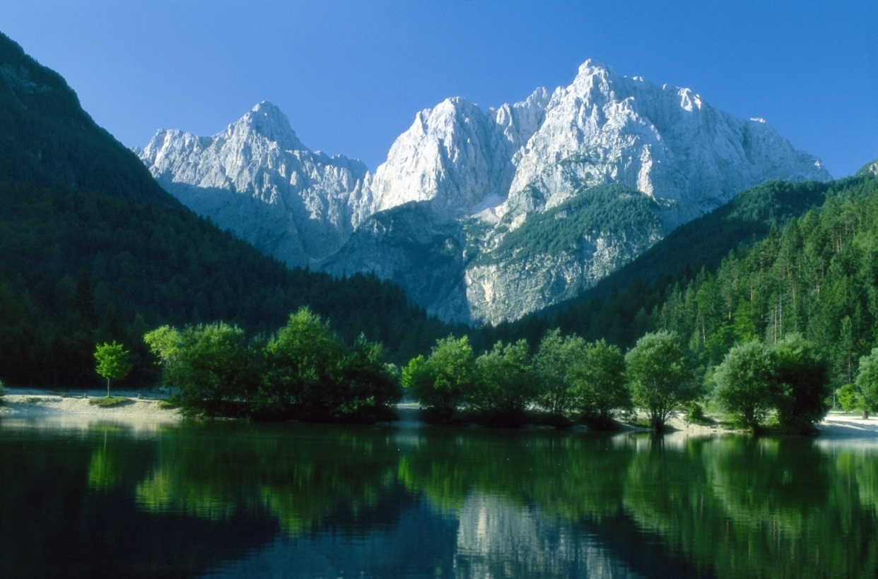
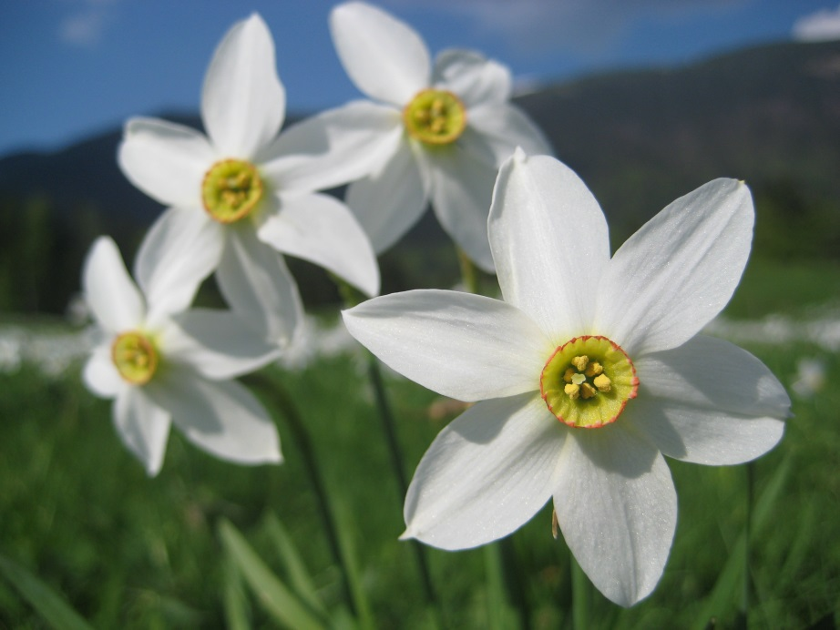
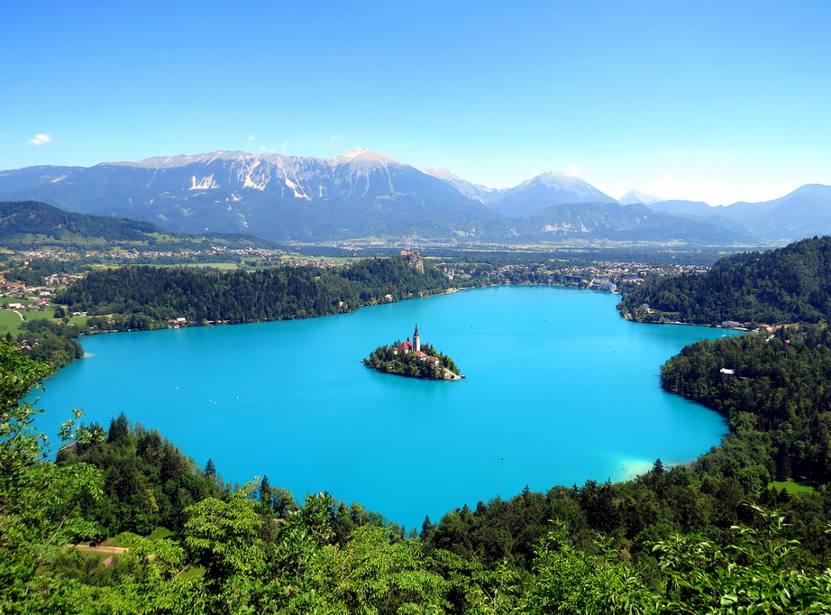

Slide 6
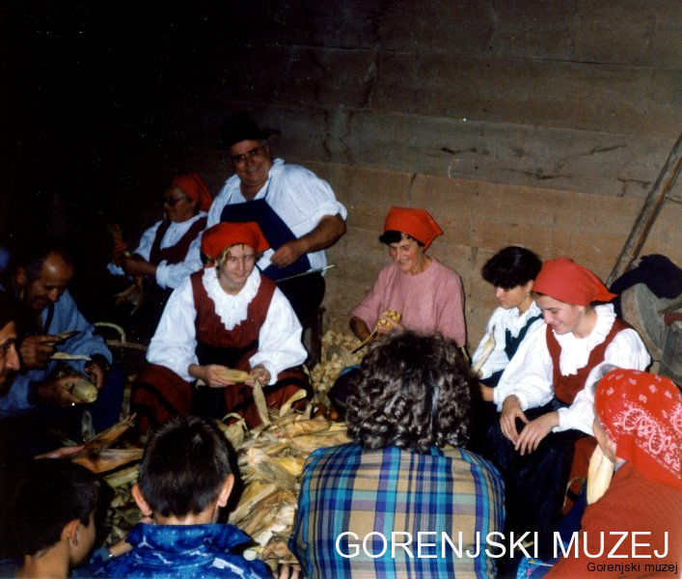
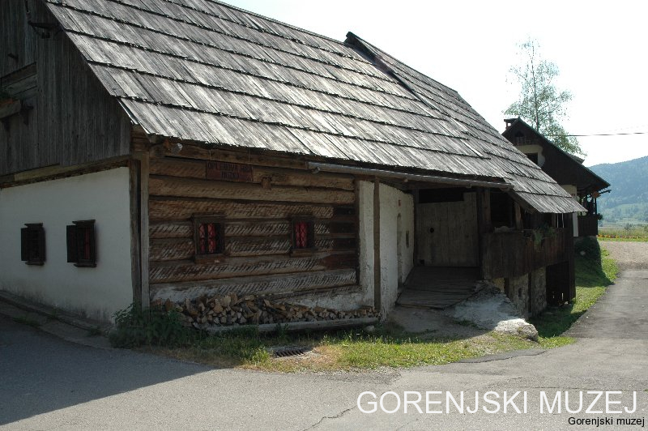
Change of paradigm – guests entering in our living room –respecttradition/modern

Slide 7
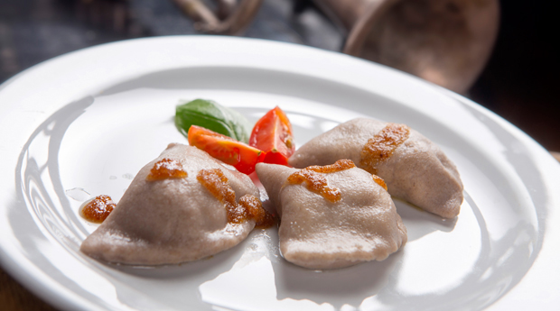
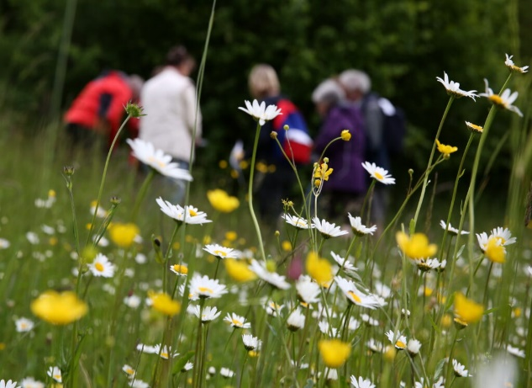
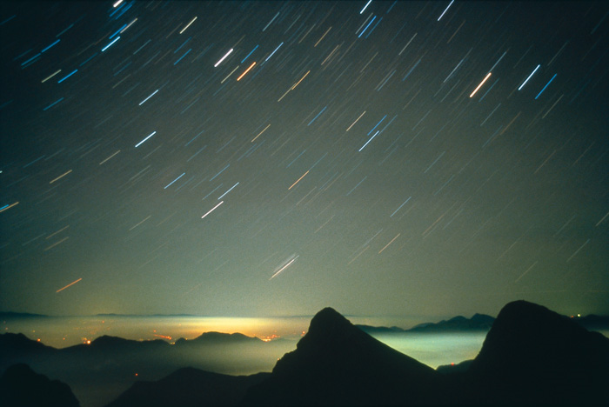
New offer - off season
Wild flower festival Bohinj
Exclusive local culinary experience on steam train –national reward from Bohinj to Soča Valley cooperation of Higher school for tourism and catering and Slovenian railway company and suppliers of local food
Culinary circle Taste Radovljica – several inns working together in presenting local innovative dishes
Dark sky initiative Julian Alps

Slide 8
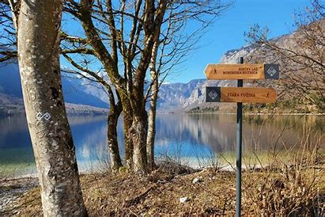
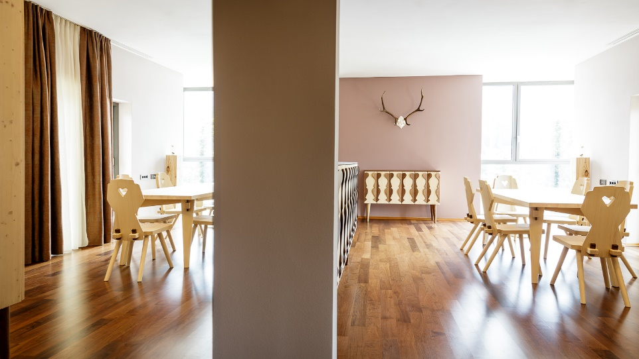
Joint work bring results joint initiatives
Biosphere reserve – joint work and cooperation:agriculture, economy, tourism, sustainable mobility, services for the inhabitants
Bohinjsko brand – same methodology –approaches for the whole Julian Alps
Julian Alps trails – trails in the valley with the wiew on highest mountain Triglav
Local materials e.g.typical new design/tradition Eco hotel

Slide 9
Sources of photos
BSC Kranj
Gorenjski muzej
Turizem Bohinj
Eco hotel Bohinj
Turizem Radovljica

